Slide 1
Writing 213
Writing for the Sciences
Remember to save this document
to your own computer
Your
Personal
Textbook
The Class Notes should be used in conjunction
with the Video Lessons for completing assignments
and learning Scientific Writing principles.

Slide 2
Course Notes: Writing 213
Table of Contents
Science Principles/Major Concepts | 3
Overview: General Effective Writing Concepts | 48
Details, Specifics, Definitions | 57
Visuals | 77
Page Design | 86
Scientific Reports | 95
Writing and Editing; Proofreading | 105
When completing
assignments, you may
need to refer to more
than one section.
Be sure to use the
templates on the web
site for the writing
assignments.

Slide 3
Science Writing
Principles
and
Major Concepts

Slide 4
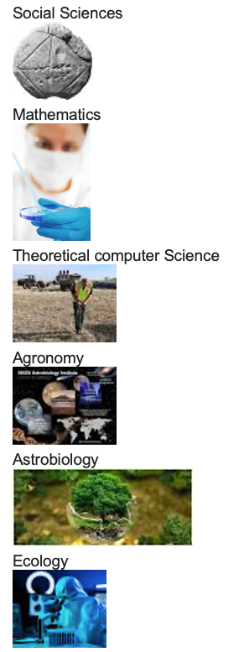
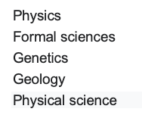
Examples:
Branches
Of
Science
Logic
Forensic science

Slide 5
Examples: Definitions Of Science
Science is the pursuit and application of knowledge and understanding of the natural and social world following a systematic methodology based on evidence. Scientific methodology includes the following: Objective observation: Measurement and data (possibly although not necessarily using mathematics as a tool) Evidence.
The best definition of science is a method of asking testable questions based on a hypothesis. A question that is testable is one that can be gathered through observation, measured by collecting data that is quantitative or qualitative and observed through experimentation.
Science is the field of study concerned with discovering and describing the world around us by observing and experimenting. Biology, chemistry, and physics are all branches of science. Science is an "empirical" field, that is, it develops a body of knowledge by observing things and performing experiments.
Science is the systematic study of the phenomena in the physical world gain through observation and experiments.
Science is defined as the:
observation,
identification,
description,
experimental investigation, and
theoretical explanation
of natural phenomena.
A one word definition of science: Knowledge.
The word itself comes from Latin, and its root verb, scio, scire means “to know.”

Slide 6
Writing a Scientific Paper

Slide 8
Scientific Writing Introduction
While writing is a critical part of the scientific process, it is often taught secondarily to scientific concepts and becomes an afterthought to students. How many students can you recall who worked on a laboratory assignment or class project for weeks, only to throw together the written report the day before it was due?
For many, this pattern occurs because we focus almost exclusively on the scientific process, all but neglecting the scientific writing process.
Scientific writing is often a difficult and arduous task for many students. It follows a different format and deviates in structure from how we were initially taught to write, or even how we currently write for English, history, or social science classes.
This can make the scientific writing process appear overwhelming, especially when presented with new, complex content. However, effective writing can deepen understanding of the topic at hand by compelling the writer to present a coherent and logical story that is supported by previous research and new results.

Slide 10
Formatting Scientific Writing
Clear scientific writing generally follows a specific format with key sections:
• an introduction to a particular topic,
• hypotheses to be tested,
• a description of methods, key results,
• a discussion that ties these results to our broader knowledge of the topic.
This general format is inherent in most scientific writing and facilitates the transfer of information from author to reader if a few guidelines are followed.

Slide 12
The Before Steps
The scientific writing process can be a daunting and often procrastinated “last step” in the scientific process, leading to cursory attempts to get scientific arguments and results down on paper. However, scientific writing is not an afterthought and should begin well before drafting the first outline. Successful writing starts with researching how your work fits into existing literature, crafting a compelling story, and determining how to best tailor your message to an intended audience.
Research how your work fits into existing literature
It is important to decide how your research compares to other studies of its kind by familiarizing yourself with previous research on the topic. If you are preparing a laboratory write-up, refer to your textbook and laboratory manual for background information. For a research article, perform a thorough literature search on a credible search engine (e.g., Web of Science, Google Scholar). Ask the following questions: What do we know about the topic? What open questions and knowledge do we not yet know? Why is this information important? This will provide critical insight into the structure and style that others have used when writing about the field and communicating ideas on this specific topic. It will also set you up to successfully craft a compelling story, as you will begin writing with precise knowledge of how your work builds on previous research and what sets your research apart from the current published literature.
Understand your audience (and write to them)
In order to write effectively, you must identify your audience and decide what story you want them to learn. While this may seem obvious, writing about science as a narrative is often not done, largely because you were probably taught to remain dispassionate and impartial while communicating scientific findings. The purpose of science writing is not explaining what you did or what you learned, but rather what you want your audience to understand. Start by asking:
Who is my audience?
What are their goals in reading my writing?
What message do I want them to take away from my writing?
There are great resources available to help science writers answer these questions. If you are interested in publishing a scientific paper, academic journal websites also provide clear journal mission statements and submission guidelines for prospective authors. The most effective science writers are familiar with the background of their topic, have a clear story that they want to convey, and effectively craft their message to communicate that story to their audience.

Slide 13
Scientific Writing Steps
Introduction
The Introduction sets the tone of the paper by providing relevant background information and clearly identifying the problem you plan to address. Think of your Introduction as the beginning of a funnel: Start wide to put your research into a broad context that someone outside of the field would understand, and then narrow the scope until you reach the specific question that you are trying to answer (See next page).
Clearly state the wider implications of your work for the field of study, or, if relevant, any societal impacts it may have, and provide enough background information that the reader can understand your topic.
Perform a thorough sweep of the literature; however, do not parrot everything you find. Background information should only include material that is directly relevant to your research and fits into your story; it does not need to contain an entire history of the field of interest.
Remember to include in-text citations in the format of (Author, year published) for each paper that you cite and avoid using the author's name as the subject of the sentence.
Framing a scientific paper. The structure of a paper mirrors that of an hourglass, opening broadly and narrowing to the specific question, hypothesis, methods, and results of the study. Effective papers widen again in the discussion and conclusion, connecting the study back to the existing literature and explaining how the current study filled a knowledge gap.
Upon narrowing the background information presented to arrive at the specific focus of your research, clearly state the problem that your paper addresses. The problem is also known as the knowledge gap, or a specific area of the literature that contains an unknown question or problem (e.g., it is unclear why cowbird nestlings tolerate host offspring when they must compete with host offspring for food). The knowledge gap tends to be a small piece of a much larger field of study. Explicitly state how your work will contribute to filling that knowledge gap. This is a crucial section of your manuscript; your discussion and conclusion should all be aimed at answering the knowledge gap that you are trying to fill. In addition, the knowledge gap will drive your hypotheses and questions that you design your experiment to answer.

Slide 14
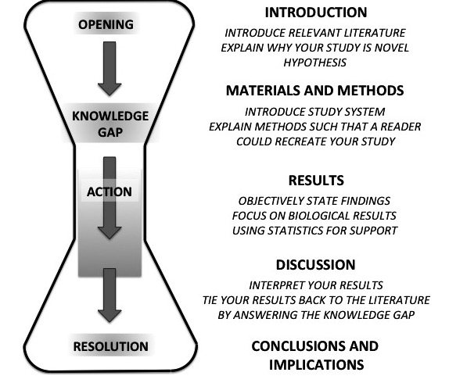

Slide 15
Hypothesis
A hypothesis is a testable explanation of an observed occurrence in nature, or, more specifically, why something you observed is occurring. Hypotheses relate directly to research questions, are written in the present tense, and can be tested through observation or experimentation. Although the terms “hypothesis” and “prediction” are often incorrectly used interchangeably, they refer to different but complementary concepts. A hypothesis attempts to explain the mechanism underlying a pattern, while a prediction states an expectation regarding the results. While challenging to construct, hypotheses provide powerful tools for structuring research, generating specific predictions, and designing experiments.
Example:
Observation: Brown-headed cowbird nestlings refrain from ejecting host offspring from the nest even though those offspring compete for limited parental resources.
Research question: Why do nestling cowbirds tolerate the presence of host offspring in the nest?
Hypothesis: The presence of host offspring causes parents to bring more food to the nest.
Prediction: Cowbird nestlings will grow at a faster rate in nests that contain host offspring.
Cowbirds are obligate brood parasites, meaning that they never build their own nest. Instead, they lay their eggs in the nests of host species, and let those parents raise their chicks. Cowbirds are nest generalists, and have been found to lay eggs in the nests of 247 different species of birds.

Slide 16
Materials and Methods
The Materials and Methods section is arguably the most straightforward section to write; you can even begin writing it while performing your experiments to avoid forgetting any details of your experimental design. In order to make your paper as clear as possible, organize this section into subsections with headers for each procedure you describe (e.g., field collection vs. laboratory analysis). Use these headers in your Results and Discussion to help orient your readers.
The aim of the Materials and Methods section is to demonstrate that you used scientifically valid methods and provide the reader with enough information to recreate your experiment. In chronological order, clearly state the procedural steps you took, remembering to include the model numbers and specific settings of all equipment used (e.g., centrifuged in Beckman Coulter Benchtop Centrifuge Model Allegra X -15R at 12,000 × g for 45 minutes). In addition to your experimental procedure, describe any statistical analyses that you performed. If you followed a procedure developed from another paper, cite the source that it came from and provide a general description of the method. There is no need to reiterate every detail, unless you deviated from the source and changed a step in your procedure. However, it is important to provide enough information that the reader can follow your methods without referring to the original source.
The Materials and Methods section should be written in the past tense (for example):
“On hatch day, and every day thereafter for 9 days, we weighed chicks, measured their tibia length, and calculated the instantaneous growth constant K to summarize rates of mass gain and skeletal growth.”
While it is generally advisable to use active voice throughout the paper, you may want to use a mixture of active and passive voice in the Materials and Methods section in order to vary sentence structure and avoid repetitive clauses.

Slide 17
Common parameters included in the Materials and Methods section
• Site characterization:
Study organism used, its origin, any pre-experiment handling or care
Description of field site or site where experiment was performed
• Experimental design: Detailed items (not all of which need to be used
Step-by-step procedures in paragraph form
Sample preparation
Experimental controls
Equipment used, including model numbers and year
Important equipment settings (e.g., temperature of incubation, speed of centrifuge)
Amount of reagents used
Specific measurements taken (e.g., wing length, weight of organism)
• Statistical analyses conducted (e.g., ANOVA, linear regression)

Slide 18
Results
The Results section provides a space to present your key findings in a purely objective manner and lay the foundation for the Discussion section, where those data are subjectively interpreted. Before diving into this section, identify which graphs, tables, and data are absolutely necessary for telling your story. Then, craft a descriptive sentence or two that summarizes each result, referring to corresponding table and figure numbers. Rather than presenting the details all at once, write a short summary about each data set.
As you relate each finding, be as specific as possible and describe your data biologically rather than through the lens of statistics. While statistical tests give your data credibility by allowing you to attribute observed differences to nonrandom variation, they fail to address the actual meaning of the data. Instead, translate the data into biological terms and refer to statistical results as supplemental information, or even in parenthetical clauses. For example, if your dependent variable changed in response to a treatment, report the magnitude and direction of the effect, with the P-value in parentheses.
Example: “By day 8, cowbirds reared with host young were, on average, 14% heavier than cowbirds reared alone.
If your P-value exceeded 0.05 (or your other statistical tests yielded nonsignificant results), report any noticeable trends in the data rather than simply dismissing the treatment as having no significant effect.
Writing the Results Section of a Scientific Document
1. Ensure clarity and conciseness
3. Stick to the facts
2. Visual aids for enhanced understanding
4. Relate results to research questions

Slide 19
Discussion and Conclusion
The Discussion section usually requires the most consideration, as this is where you interpret your results. Your Discussion should form a self-contained story tying together your Introduction and Results sections. One potential strategy for writing the Discussion:
Begin by explicitly stating the main finding(s) of your research.
Remind the reader of the knowledge gap identified in the Introduction to re-spark curiosity about the question you set out to answer.
Explicitly state how and why your experiment is important.
The conclusion, generally located in its own short section or the last paragraph of the Discussion, represents your final opportunity to state the significance of your research. Rather than merely restating your main findings, the conclusion should summarize the outcome of your study in a way that incorporates new insights or frames interesting questions that arose as a result of your research. Broaden your perspective again as you reach the bottom of the hourglass figure in the previous pages. While it is important to acknowledge the shortcomings or caveats of the research project, generally include these near the beginning of the conclusion or earlier in the Discussion. You want your take-home sentences to focus on what you have accomplished and the broader implications of your study, rather than your study's limitations or shortcomings. End on a strong note.

Slide 21
Putting it all together
No matter how many boards you stack on top of each other, you still need nails to prevent the pile from falling apart. The same logic applies to a scientific paper. Little things—such as flow, structure, voice, and word choice—will connect your story, polish your paper, and make it enjoyable to read.
First, a paper needs to flow. The reader should easily be able to move from one concept to another, either within a sentence or between paragraphs. To bolster the flow, constantly remind yourself of the overarching story; always connect new questions with resolutions and tie new concepts to previously presented ideas. As a general rule, try to maintain the same subject throughout a section and mix up sentence structure in order to emphasize different concepts. Keep in mind that words or ideas placed toward the end of a sentence often convey the most importance.
The use of active voice with occasional sentences in passive voice will additionally strengthen your writing. Scientific writing is rife with passive voice that weakens otherwise powerful sentences by stripping the subjects of action. However, when used properly, the passive voice can improve flow by strategically placing a sentence's subject so that it echoes the emphasis of the preceding sentence. Compare the following sentences:
“The cowbird nestlings tolerated the host nestlings.”
(active)
“The host nestlings were tolerated by the cowbird nestlings.”
(passive)
If host nestlings are the focus of the paragraph as a whole, it may make more sense to present the passive sentence in this case, even though it is weaker than the active version. While passive and active voices can complement each other in particular situations, you should typically use the active voice whenever possible.
Lastly, word choice is critical for effective storytelling. Rather than peppering your report or manuscript with overly complicated words, use simple words to lay the framework of your study and discuss your findings. Eliminating any flourish and choosing words that get your point across as clearly as possible will make your work much more enjoyable to read.

Slide 22
Editing and peer review
Although you have finally finished collecting data and writing your report, you are not done yet! Re-reading your document and incorporating constructive feedback from others can make the difference between getting a document accepted or rejected from a journal or receiving one letter grade over another on a report. The editing stage is where you put the finishing touches on your work.
Start by taking some time away from your paper. Ideally, you began your paper early enough that you can refrain from looking at it for a day or two. However, if the deadline looms large, take an hour break at the very least. Come back to your paper and verify that it still expresses what you intended to say. Where are the gaps in your story structure? What has not been explained clearly? Where is the writing awkward, making it difficult to understand your point? Consider reading the paper out loud first, and then print and edit a hard copy to inspect the paper from different angles.
Editing is best done in stages. On the first run-through of your paper, make sure you addressed all of the main ideas of the study. One way to achieve this is by writing down the key points you want to hit prior to re-reading your paper. If your paper deviates from these points, you may need to delete some paragraphs. In contrast, if you forgot to include something, add it in. To check the flow of your paragraphs, verify that a common thread ties each paragraph to the preceding one, and similarly, that each sentence within a paragraph builds on the previous sentence. Finally, re-read the paper with a finer lens, editing sentence structure and word choice as you go to put the finishing touches on your work. Grammar and spelling are just as important as your scientific story; a poorly written paper will have limited impact regardless of the quality of the ideas expressed.
After editing your own paper, ask someone else to read it. A classmate is ideal because he/she understands the assignment and could exchange papers with you. The editing steps described above also apply when editing someone else's paper. If a classmate is not available, try asking a family member or a friend. Having a fresh set of eyes examine your work may help you identify sections of your paper that need clarification. This procedure will also give you a glimpse into the peer review process, which is integral to professional science writing. Don't be discouraged by negative comments—incorporating the feedback of reviewers will only strengthen your paper. Good criticism is constructive.

Slide 23
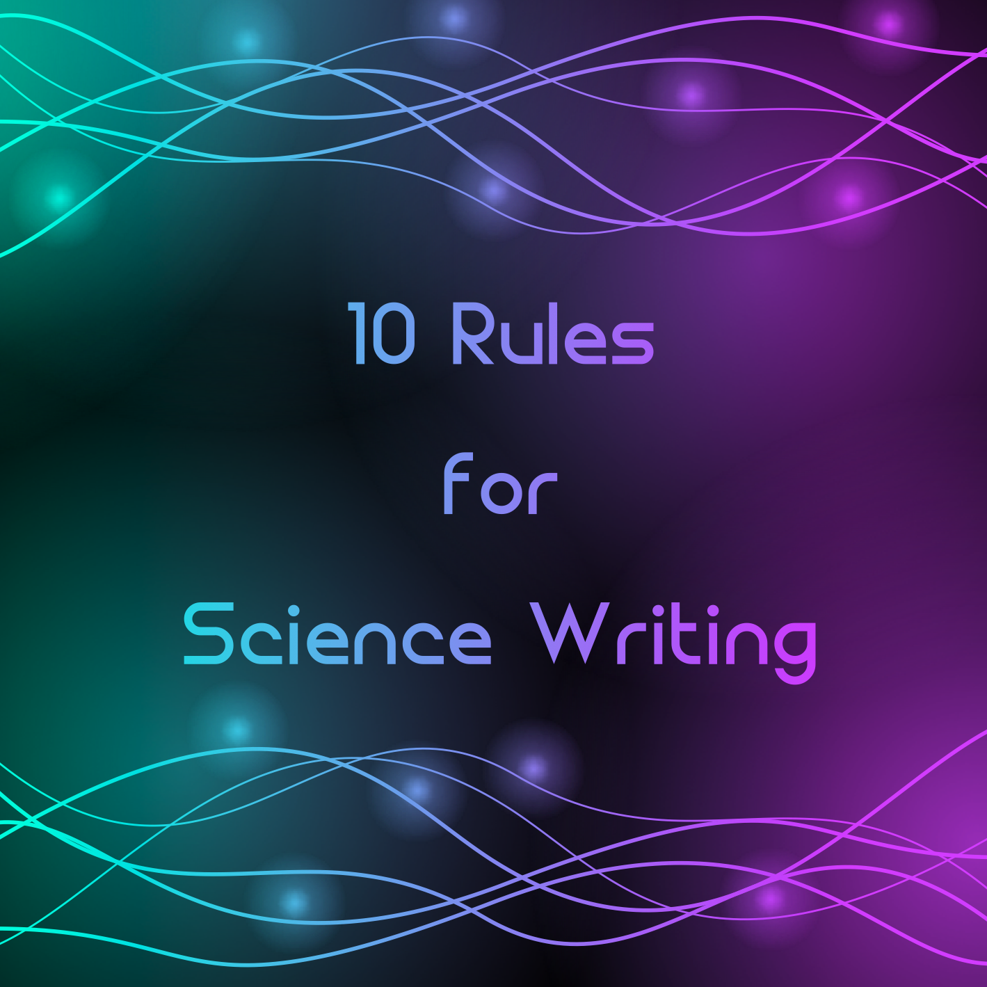

Slide 24
Ten Rules
Rule 1: Take writing seriously
Conciseness alone does not ensure good scientific writing. However, good science writing that is not concise is rare (or non-existent), so pursuing conciseness as part of a larger strategy to write effectively is worthwhile. From emails to manuscripts, the ability to make points clearly and efficiently is perhaps the most important writing skill you can develop. However, if you think you will always nail it on the first attempt, you will be mistaken. Before you can write well, you must get comfortable receiving feedback and revising your work (see Rule 10). Great writing blooms from great revision, and great revision starts with listening to feedback. But it all begins and ends with putting time and effort into your writing.
Rule 2: Identify and stick to your message
As early in the writing process as possible, you should identify your message. What is your document's goal? Can you summarize the key points in a few sentences? Add summary sentences to the top of my working document so you see them often. Regardless, once your guide is set, every paragraph and sentence should flow from that overarching roadmap. In other words, you must stick to your message.
It is also important that your manuscripts and even individual sentences not read like mysteries. Your reader is experiencing your thoughts for the first time. They cannot predict where you are going. And, even if they can, making them try distracts from their most important job: reading and considering what you wrote. Give the reader an early roadmap so everything you lay out fits the picture they already have in mind. By connecting each part of your paper to a larger, overarching message, you will build one of the world's most powerful communication tools: narrative.
Rule 3: Get to the point
You and your audience have a mutual goal: transferring information as efficiently as possible. Long-winded setups, extra details, and irrelevant tangents undermine that goal. At best, they waste the reader's time. At worst, they confuse or cause them to stop reading. As you write, a little voice in your head should be reminding you to get to your point as efficiently as possible for everyone's sake.

Slide 25
Ten Rules
Rule 4: Keep your Methods and Results contained
Text that should be in the Methods and Results has a way of creeping into other parts of a document where they do not belong. Read and re-read your documents with an eye towards moving anything better suited to the Methods or Results to those sections. If you find the information is already there, delete it.
Rule 5: Do not repeat yourself (too often)
Redundancy is the bane of conciseness and repetitive papers come across as lazy. Of course, there are places (e.g., Conclusions) where reiteration can guide the reader to a bigger message. But in general, once you state something, it only needs to be repeated to add key information (e.g., differentiating between two approaches when describing results). It is also unnecessary to repeat content in figures and tables elsewhere in the document.
Rule 6: Avoid unnecessary or inefficient “lead-ins”
When writing a scientific article, unnecessary “lead-ins” undermine brevity. If you are unclear what I mean by an unnecessary “lead-in,” re-read the first sentence of this section. Do I need “when writing a scientific article” to set up the sentence? No. The sentence should begin with “unnecessary” and with that simple edit, its length drops from nine to four words. See next page.
Rule 7: Use first-person, active voice
First-person, active voice is generally tighter and, in my view, more interesting as it allows the writer to describe the actions they performed from their perspective. We collected the data this way. I argue this point. Our finding is interesting for this reason. First-person, active voice puts key subjects and actions at the beginning of the sentence which helps you get to the point quickly and avoid inefficient sentences. It should be noted, however, that situations may arise that require passive voice. For instance, if the author(s) did not collect the data being referred to, then referencing its collection passively (i.e., “Samples were collected…”) is appropriate.

Slide 26
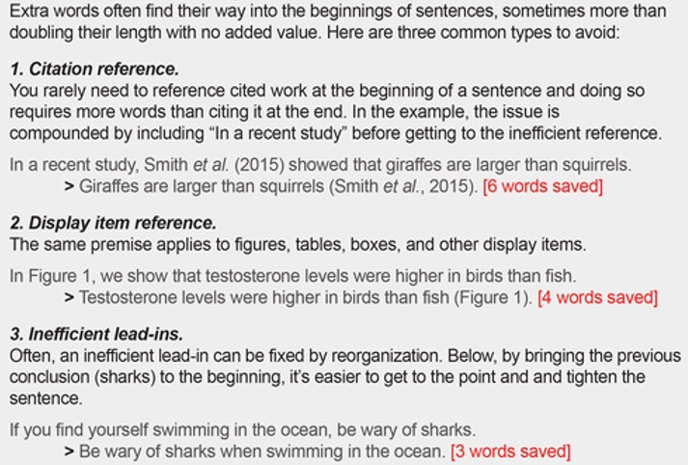
Ten Rules
Rule 6: Avoid unnecessary or inefficient “lead-ins”

Slide 27
Ten Rules
Rule 8: Remove unnecessary words
“The road to hell is paved with adverbs. Stephen King, On Writing: A Memoir of the Craft (2000)
Two types of “filler” sneak into sentences: extra words or phrases that can be removed with no effect on the message and phrases that can be condensed from several words to one or two. Sentence filler generally consists of three features being overused: (1) qualifiers, (2) prepositional phrases, and (3) transitions. However, they are not mutually exclusive and often co-occur.
(1) Qualifiers are usually adverbs that modify or enhance other words in a sentence (e.g., quickly, extremely, frequently). They often add nothing and can be removed.
(2) Extraneous prepositional phrases (e.g., in this case, among other writers, on the other hand, for the most part) or similar multi-word setups can make sentences feel jumbled and unclear. While it may be hard to cut a phrase entirely, look to replace multi-word phrases with single words. Switching from passive to active voice (see Rule 7) can also help reduce overuse of prepositional phrases.
(3) Transitions—words that link one sentence to the next (e.g., however, meanwhile, thus)—can be important, but odds are you include more than you need. Work to remove extraneous transitions and, if possible, combine sentences. See next page.
Rule 9: Simplify your language
"Use the smallest word that does the job.” E.B. White
You do not need complicated words and clever phrasing to write well. They take up space, waste time, and may cause your message to be misinterpreted. As you revise to reduce your word count, you should also try to reduce your manuscript's syllable count by using shorter words wherever possible. See page after next.

Slide 28
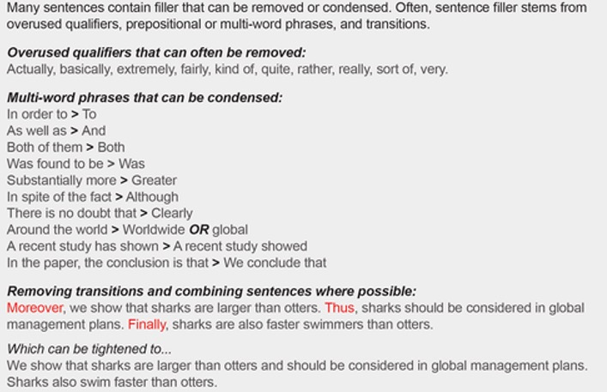
Ten Rules
Rule 8: Remove Unnecessary Words

Slide 29
Ten Rules
Rule 9: Simplify your language

Slide 30
Ten Rules
Rule 10: Seek and embrace feedback
Diagnosing editorial issues in your own writing is difficult. Thus, good feedback is as important as the writing itself. From the perspective of conciseness, for instance, it is hard to see alternative, tighter ways to phrase something, to notice when you are repeating yourself, or to identify places where your narrative has strayed from the overarching goal. While all editorial feedback will not be focused on conciseness, plenty will. You can also direct those giving you feedback to focus on certain components of your manuscript.
Helpful editorial input will not happen magically, however, even with the right co-author, peer, or supervisor. It starts with you—the writer—and the feedback environment you construct. Are you overconfident and quick to ignore people's input? Do you take feedback seriously? Are you kind to those giving you feedback (especially those that are well-intentioned but critical)? While difficult to hear, having a friend or reviewer let you know when something is not ready for publication due to major flaws will save you considerable trouble in the long run.
Three recommendations:
First, take the plunge and send your work to people who you can trust to be critical when warranted. While a pat on the back or “Looks great!” message may feel good in the short-term, a lack of critical feedback before submission or publication is a recipe for disaster.
Second, take feedback graciously. You are asking someone to do something difficult—to spend their time reading your work and telling you how they think it could be improved. This is no small feat. People are busy and do not want to hurt your feelings, especially when you are their peer or mentee.
Third, take feedback seriously. Many writers, and particularly those early in their career, cannot properly assess their own writing and tend to be overconfident. They are at least unaware of the effort required to produce high-quality work. So, it is important to be humble when taking criticism. Disagreements about wording or style are common. They are what make writing more art than science. But, to dismiss someone's feedback outright, or to assume you know best, undermines the process, weakens your writing, and wastes everyone's time.
However, if you lack confidence, be careful not to blindly accept comments or edits as absolute truth. Consider each one carefully, ask for clarification when needed, and trust your own intuition when you are not sure about something. If a problem is noted, your critic is likely correct that something is amiss where they specified. However, they may not necessarily be right about how to fix it.

Slide 31
Style Points for Scientific Writing
Scientific writing follows a specific style convention. Its goal is to convey quantitative information about research as efficiently as possible, resulting in writing that is easy to scan. Writing styles used in disciplines like history or literature are not useful when writing scientifically because they do not lend themselves to efficiently presenting research findings. Below are some guidelines for scientific writing.
1. Sentences and paragraphs. Aim for brevity.
Use simple sentences to convey complex information. Longer sentences are harder to understand and to remember. They also often lead to grammatical errors. Aim for one idea per sentence: New idea, new sentence. Don't run on.
Keep paragraphs short. As with sentences, keep to one idea per paragraph: New idea, new paragraph. This can result in short paragraphs. That’s okay! If you have fewer than two paragraphs per double-spaced page, look for natural breaks. If none exist, you may need to reorganize.
2. Correct verb tense.
•Use present tense for generalizations and stable conditions. For example, to describe a theory that is currently held: "Theory of mind refers to..."
•Use past tense when referring to previous research, methods, and results, because these have occurred in the past: "Sudley (1969) showed...", "We found..."
In general, these are the verb tenses typically used in each section of a research paper.
3. Passive versus active voice.
Active voice is usually clearer and more to the point. For example, "Birds build nests" is clearer than "Nests are built by birds," and "I found" is clearer than "It was discovered." Use passive voice if it is clearer, but favor using active voice: subject, verb, and object.
Passive: Extra credit was given to subjects in exchange for participation.
Active: Subjects received extra credit in exchange for participation.

Slide 32
4. Correct word use.
Be precise: Make every word mean what you want it to mean. Be clear: Use the simplest word that is also the most precise one. The following words are commonly misused in scientific writing.
Significant. Use in a statistical context only. The opposite of significant is "nonsignificant" (not "insignificant"). Significance refers to differences, not results.
Yes: The differences between the control and experimental groups were nonsignificant.
No: The differences were insignificant. The results were nonsignificant.
This theory has significant implications for women as well as men.
Confound vs. Extraneous Variable. A confound refers to an unplanned factor that covaries with one experimental condition and may affect the results of an experiment. An extraneous variable is an uncontrolled factor that equally affects both experimental and control conditions. Confounds are often confused with extraneous variables.
No: The results were confounded because the thermostat failed during testing on a hot day, and participants in both experimental and control groups expressed discomfort.
(Describes an extraneous variable, not a confound, because both groups in the study experienced discomfort from the heat.)
Yes: In the control group, the thermostat failed and room temperature rose to uncomfortable levels, and this may have confounded the results.
Former and Latter. Avoid using these words to refer to something previously stated. Doing so doesn't save many words, and the reader has to backtrack to determine which was which. Just write out what you are referring to.
Which vs. That
“That” precedes information that is necessary to understand the rest of the sentence.
Fiske and Glick (1996) argued that benevolent and hostile sexism arise from the biological and social conditions that many societies share.
“Which” precedes information that is not necessary to understand the rest of the sentence.
The social dominance orientation scale, which had good reliability, predicted 80% of the variance in racial attitudes.
Generally, if changing "which" to "that" does not alter the meaning, then "that" is probably correct.
Because vs. Since. “Because” refers to the cause or reason for an outcome. “Since” refers to the passage of time.
Less vs. Fewer “Less”: Since Steele and Aronson (1995) first demonstrated stereotype threat among African American students, researchers have replicated this phenomenon in many different groups.
Use to refer to collective noun (e.g., "less time"). Use to refer to multiple items (e.g., "fewer copulations").
No: Type II motor skill nest building behavior Yes: Nest building behavior involving type II motor skills

Slide 33
5. Needless words.
Make every word mean something. Eliminate unnecessary words. Avoid adverbs, such as "very," "quite," "rather," and "somewhat." These words are not quantitative and do not add helpful information.
Below are examples of words that are useless or incorrect in scientific writing, with suggested alternatives (notice that the “don’t use” column is wordier than the “better” column):
Don't use plays an important role due to the fact that
a decreased number of a great deal of a majority of a number of
a small number of time period, time interval longer time period larger in size brown in color round in shape adjacent to has been shown to be it is possible that in case
Better evidence support fewer much most many, some a few
time or interval longer larger
round next to, near is may if
6. Avoid noun strings (piling up nouns in front of the noun they modify).
in this case in most cases in all cases demonstrate, exhibit utilize in other words 7. Proofread. Your paper has your name on it. It represents you. Make sure that the hard work that you spend on the content of your paper is reflected in the literacy of your writing. Don't be responsible for careless errors such as these: "The participants where divided intotwo groups eight. both groups was consented at the beginning of teh experiment.."
former or latter adverbs in this experiment/study it is interesting to note that it would thus appear that it may seem reasonable to suppose that

Slide 34
Tips to Improve your Scientific Writing
1. Organize your thoughts, ideas, and actions in a logical manner
Begin with sufficient background information to take your reader along the pathway from your observations to your hypothesis. Describe the background to appeal to a broad group of readers. Provide sufficient context to communicate the significance of your inquiry and experimental findings. Omit extraneous information so that the reader can obtain a clear picture. Group similar ideas together and state your ideas and thoughts concisely. Present ideas in a consistent manner throughout the manuscript. The most common structure of a scientific manuscript is the IMRAD (Introduction, Methods, Results, and Discussion) format.
2. Provide clear descriptions
Repeat complex concepts as needed, explaining them from various angles. Begin with simplicity, advancing complexity as required for comprehension. Tailor your writing to your audience’s level of expertise, whether they understand specialized terms or require prior explanations. Keep your explanations straightforward.
3. Simplify your word choices
Utilize clear, straightforward language to ensure that both students and researchers, regardless of their field or English proficiency, can easily comprehend and engage with your research.
4. Write concisely
Note that this article mentions “concise writing” several times. Avoid lengthy or needless descriptions and paragraphs, as nobody values them.
5. Use passive and active voice appropriately
In science writing, it is important to know when to use passive and active voice. Using active voice makes your writing more natural, direct, and engaging, and you should employ it when discussing widely accepted findings. The Introduction section should primarily employ active voice because it narrates “what is.” However, when discussing the results of a particular study, it’s advisable to use passive voice. In the Methods and Results sections, passive voice should be employed to describe what you did and what you found. In the Discussion section, a mixture of passive and active voice is acceptable, but take care not to mix the 2 together in a single sentence.

Slide 35
6. Select the most appropriate word
Selecting the appropriate words can be challenging. The best words accurately capture what the author is trying to convey. If a word is not sufficiently precise, use a thesaurus to replace the word or phrase with a more appropriate word. Precise words allow for specific, clear, and accurate expression. While science writing differs from literature in that it does not need to be colorful, it should not be boring.
7. Broaden your vocabulary
Use clear, specific, and concrete words. Expand your vocabulary by reading in a broad range of fields and looking up terms you don’t know.
8. Avoid filler words
Filler words are unnecessary words that are vague and meaningless or do not add to the meaning or clarity of the sentence. Consider the following examples: “it is”, “it was”, “there is”, and “there has been”, “it is important“, “it is hypothesized that“, “it was predicted that“, “there is evidence suggesting that“, “in order to”, and “there is a significant relationship“. All of these phrases can be replaced with more direct and clear language. See our list of words and phrases to avoid here.
9. Read what you write
Ensure you vary sentence length to maintain reader engagement and avoid a monotonous rhythm. However, don’t create excessively long or convoluted sentences that might hinder the reader’s comprehension. To enhance readability, consider reading the manuscript aloud to yourself after taking a break or having someone else review it.
10. Optimize paragraph and sentence structure
Each paragraph should present a single unifying idea or concept. Extremely long paragraphs tend to distract or confuse readers. If longer paragraphs are necessary, alternate them with shorter paragraphs to provide balance and rhythm to your writing. A good sentence allows readers to obtain critical information with the least effort.
Poor sentence structure interferes with the flow. Keep modifiers close to the object they are modifying. Consider the following sentence: “Systemic diseases that may affect joint function such as infection should be closely monitored.” In this example, “such as infection” is misplaced, as it is not a joint function, but rather a systemic disease. The meaning is more clear in the revised sentence: “Systemic diseases such as infection that may affect joint function should be closely monitored.”
11. Use transitions to control the flow
Sentences and paragraphs should flow seamlessly. Place transitional phrases and sentences at the beginning and end of the paragraphs to help the reader move smoothly through the paper.

Slide 36
12. Word repetition
Avoid repetitive use of the same word or phrase; opt for a more descriptive alternative whenever possible. Ensure that you do not sacrifice precision for variability. See science-related Word Choice list here
13. Improve readability with consistent formatting
Although in many cases it is no longer necessary to format your manuscript for a specific journal before peer review, you should pay attention to formatting for consistency. Use the same font size throughout; format headings consistently (e.g., bolded or not bolded, all uppercase or not, italicized or not); and references should be provided in an easy-to-follow, consistent format. Use appropriate subheadings in the Materials and Methods, and Results sections to help the reader quickly navigate your paper.
14. Use parallel construction to facilitate understanding
Your hypothesis, experimental measures, and results should be presented in the same order in the Abstract, Introduction, Methods, Results, Discussion, and Tables. Words or phrases joined by coordinating conjunctions (and, but, for, nor, or, so, and yet) should have the same form.
15. Maintain consistent use of labels, abbreviations, and acronyms
Measures and variable/group names and labels should be consistent in both form and content throughout the text to avoid confusing the reader.
16. Use abbreviations and acronyms to aid the reader
Only use abbreviations/acronyms to help the reader more easily understand the paper. Follow the general rule of utilizing standard, accepted abbreviations/acronyms that appear at least 3 times in the main text of the paper. Always ask yourself, “Does this benefit me or the reader?” Exceptions might be applicable for widely-used abbreviations/acronyms where spelling them out might confuse the reader.
17. Minimize pronoun use for clarity
Make sure every pronoun is very clear, so the reader knows what it represents. In this case, being redundant may contribute to the clarity. Don’t refer to ‘this’ or ‘that’ because it makes the reader go back to the previous paragraph to see what ‘this’ or ‘that’ means. Also, limit or avoid the use of “former” and latter”.
18. Read your writing out loud
To assess the rhythm and identify repetitive words and phrases both within and between sentences and paragraphs, read your final paper aloud. Frequently, you will encounter unnecessary words that can be removed or substituted with more suitable alternatives. Remember, your writing is your chance to show the scientific world who you are. You want to present a scholarly, clear, well-written description of your interests, ideas, results, and interpretations to encourage dialogue between scientists. Change your goal from that of simply publishing your manuscript to that of publishing an interesting manuscript that encourages discussion and citation, and inspires additional questions and hypotheses due to its fundamental clarity to the reader.

Slide 38
The Secrets of Science Writing
Read: Learn what makes other writing good. By reading, you imbibe other writers’ styles and techniques, mix them with your own abilities and creative stance, and end up with a style all of your own. Read Hemingway and Shakespeare. Read the Brontës and Virginia Woolf. Read features and news articles online and in newspapers and magazines.
Craft your words: The general rule for clear writing is: think about what you want to write before you want to write it and write it in the clearest way possible. Be sure to:
§ avoid excessive use of jargon: if you must use it, explain its meaning clearly
§ be original in your use of language and generally avoid clichés or slang (but remember that great writers do use clichés for particular effects, having thought about them carefully first)
§ avoid ugly, clumsy phrases and sentences all of the same length (never use a long word where a short word will do – If you can cut a word out, cut it out)
§ read your article through when you’ve finished it, and cut as many words as you can.
Start as you mean to go on: The beginning of your article is crucial. It must be a hook to grab the attention of the reader. If you haven’t drawn in the reader during the first few sentences, you’ve lost them. Consider opening your article with:
§ an unusual, shocking or quirky fact
§ a fictional narrative that draws the reader in by placing them right in the middle of a scene that they can imagine (be sure to minimize irrelevant details – do not be flowery)
§ an intriguing question (how could a reader not resist finding out the answer by reading on?)
§ a quote, but not an overly long one (it’s only a hook, not a walk-in wardrobe)
Or you could think of a completely original way to start. Whatever you choose, make sure your opening is relevant to the topic you’re writing about, and not simply stuck on like a piece of lace.

Slide 39
Tell the story
So, what about the middle? As this exercise is writing about your research, the main part of your article should be exactly that.
Lead us through the story of the science
What do you actually do? What is the ultimate goal of the research? Is it controversial in any way? If so, you’ve got a tough job because justifying it is part of your mission. Essentially, why does your research matter?
Think about the ideas first
How do you explain the ideas when speaking to someone you know. Would they understand it? Would they even care? Is there an original way of explaining it? Do not pitch too high or include too much detail. Test it out on a friend.
Be careful with analogies
They must work. Avoid excessive metaphors and beware of mixing them. Be wary of using the word ‘imagine’. If you are describing an analogy, the reader will imagine it without your instructing them to do it. Avoid anything too corny. For example, use puns with caution, except for headlines and subheadings, where puns can be effective.
Make it satisfying
The end of the article is important. It must leave the reader feeling satisfied: it’s the end of the story even if it isn’t the end of the research.
The ending can reflect ideas and themes within the article and is often a ‘kicker’, a kind of ‘twist’ which may be ironic or thoughtful, and make the reader want to know more. Read newspaper features for examples. Try not to end on a clichéd phrase.

Slide 40
Check your tone
Be careful to:
avoid making false claims about the value of your research or sensationalizing it (for example, beware of saying that you are just a few years away from a ‘breakthrough’)
resist being melodramatic (have the confidence that your writing is good enough to convey the research in an accurate, yet entertaining, way)
shun a supercilious or self-righteous tone (are you making references to your being a scientist and how virtuous you are? If your article is good, we will know how your research is benefiting society and why).
Know your tools
Finally, and perhaps most crucially, do not neglect one of the most basic rules of style, which is to make sure you know how to use your tools. Know the importance of:
language – the flow of words and sentences, and the way you can use a black and white page to conjure up colorful ideas in a reader’s mind
grammar and punctuation – they are the heart of the craft.
Do not make mistakes, because the reader may think you cannot use your tools, and not trust your finished product. Watch your commas. Understand the way sentences are constructed. Read a grammar book.
Break the rules
The last rule is very simple. You may break any of the rules mentioned here, although it helps to have understood them first. “It’s not wise to violate rules until you know how to observe them,” said T. S. Eliot. But when you know the rules, you can flout any convention and be as original and as crazy as you like.
You can take the words and use them as you would chemicals in a scientific experiment – mix them together and analyze the reaction. That is the beauty, the fun and the liberty of writing.

Slide 41
Specific Formatting
use the ‘active’ voice (do not write “I was able to see…” when you could write “I saw…” or “the cells were incubated” when you could write “I incubated the cells”)
use first names rather than titles to help personalize the research
only include important and relevant information, as readers are restless and will stop reading if you include information that is important only to fellow scientists
avoid acronyms if possible – even if a protein is known as ABC2D among scientists, it is more appropriate and understandable to use a different name for a more general audience
use technical terms only sparingly and consistently, and provide explanations if necessary
be careful with punctuation (only use a semi-colon if you are sure it is appropriate and do not overuse commas)
break up your paragraphs, as it’s hard work to read paragraphs of more than, say, 100 words (there’s no hard and fast rule for word count in paragraphs or sentences but if in doubt, put in a break).

Slide 42
Removing or Condensing Filler

Slide 43
Readability Issues
Here are six readability issues common in academic writing, and six ways to tell clearer and more compelling research stories.
1. Bad titles
Many titles are so vague they don’t tell me what the paper is about; I tend to skip them. Readers, journalists, and search engines will overlook them too.
“Can a computer think like a baby?” is eye-catching, but it holds no information about the topic or conclusion of the paper. I already know that computers don’t think like babies. Without any extra information, I would not be able to tell what the key result of the paper is. I would not even know which discipline the article belongs to.
“Quantifying research waste in ecology” is just as bad. The title tells me the general research topic and it's goal, but it says nothing about the findings.
A good title is concise and yet informative. It tells the topic and the most important conclusion. “Ecologists waste 75% of their research time” is much better. "Modest interventions complement each other in reducing misinformation" is longer, but still good.
2. Passive voice
The human mind likes stories, and stories are about people doing things. A research paper tells a story too.
Passive voice sounds formal, as in “Extensive data collection efforts were made.” But it leaves the reader unsure of who is doing what, the most important part of your story. It strips the sentence of strong verbs, and replaces them with strings of nouns (“data collection efforts”).
What the writer intends to say is that their research team collected data. The active construction is simpler and more clear.

Slide 44
3. Complex sentences
Authors overload their sentences with too many interconnected clauses. The reader loses track and has to do extra work to keep up. Some sentences so complex they can be cut into three or four and they will be much clearer.
Here is one example.
The production of knowledge is overwhelmingly skewed towards wealthy countries such as the United States and those in Western Europe and East Asia (to name a few) that house the best universities with productive research laboratories, Nobel prize winners and journal editors, so identifying under-cited countries that often can be at a disadvantage compared to widely cited regions both promotes the inclusion of often-excluded voices and helps foster the scientific enterprises of these countries.”
The authors packed three different ideas into a single sentence. Instead, they can start by saying that wealthy countries produce more knowledge than less wealthy ones. Then take the reader to the next simple idea.
Simple sentences do not sound less professional, they sound better. Science stories are complex, but you can still tell them in simple sentences.
4. Generalities
People’s minds deal in specifics. Generalities leave the reader wondering what exactly the author is talking about, and this is mentally taxing.
What does the author mean when they say “adverse health effects?” This will depend on the context, and the reader’s mind will be busy trying to figure it out. The reader may think that the writer doesn't know the specifics, and this will make your prose sound weak.
A sign warning you of adverse health effects would not be persuasive. Instead, it refers specifically to serious injury and death. So use definite, concrete language, and report the details that matter.

Slide 45
5. Overstatements
Authors often write that they “present a groundbreaking model,” or they claim that their “unprecedented results overturn the paradigm.” Self laudatory language is very common in cover letters, abstracts, and university press releases. Authors hope that this will persuade their editor, reader, and the general public.
But the result is often the opposite: the reader loses trust in your writing. When every article claims to be “groundbreaking,” none of them is. Overstatements like these are also generalities. Instead of stating that your work is novel and groundbreaking, show it. Give the reader all the information they need to understand the advance that your results provide. And trust that the reader will appreciate the importance.
6. Clutter
Clutter in science writing is all the words and phrases that sound smart, but serve no purpose.
Phrases that carry the meaning of a single word are one type of clutter. So write "we cannot" instead of “we lack the ability,” "because” and not “due to the fact that,” and “small” instead of “small in size.” Use short words: “use” not “leverage,” “show" and not “demonstrate.”
Most adverbs and adjectives are unnecessary, as their meaning is already part of their verb or noun (“a major breakthrough”). Remove all sentences and paragraphs that repeat what you have already said. Avoid imprecise expletives such as “there is” or “it has been shown.” Stop prefacing your thoughts with “it should be noted that.” If something should be noted, just say it. And trust that the reader will recognize the importance of your findings.
Finally, challenge yourself to cut the length of your first draft in half. You will be surprised by how much clutter you'll find.

Slide 46
Linking/Transition Words
Additional comments or ideas | additionally; also; moreover; furthermore; again; further; then; besides; too; similarly; correspondingly; indeed; regarding.
Alternatives | whereas; conversely; in comparison; by contrast; another view is…; alternatively; although; otherwise; instead.
Analyzing results | therefore; accordingly; as a result of; the result is/results are; the consequence is; resulting from; consequently; it can be seen; evidence illustrates that; because of this; thus; hence; for this reason; owing to x; this suggests that; it follows that; otherwise; in that case; that implies; Author (year) suggests that;
Cause / Reason | as a result of; because (mid-sentence only)
Compare | compared with; in the same way; likewise
Contrast | by contrast; although; compared with; conversely; despite; however, nevertheless; yet
Effect / Result | As a result; therefore; thus
Emphasizing earlier statements | however; nonetheless; furthermore; in the final analysis; despite x; notwithstanding x; in spite of x; while x may be true, nonetheless although; though; after all; at the same time; even if x is true; count
Introducing examples | for example; for instance; namely; such as; as follows; as exemplified by; such as; including; especially; particularly; in particular; notably; mainly;
Re-phrasing | in other terms; rather; or; better; in view of this; in contrast
Sequencing | first (ly); second (ly); third (ly); another; additionally; finally moreover; also; subsequently; eventually; next; then
Summary or Conclusion | in conclusion; therefore; to conclude; on the whole; hence; thus to summarize; altogether; overall; …following the research of…after analysis

Slide 47
Linking words: conjunctions
Linking words within a sentence are referred to as coordinating conjunctions. Do not worry about the term: think about the function.
Conjunction | Function
for | connects a reason to a result
and | connects equal and similar ideas
nor | connects two negative ideas
but | connects equal but different ideas
or | connects two equal choices
yet | connects equal and contrasting ideas
so | connects a result to a reason
Linking/Transition Words
Transitions link one main idea to another separated by a semi-colon or full-stop. When the transition word is at the beginning of the sentence, it should be followed by a comma:
Among other functions, they can signal cause and effect or sequencing (see examples in the table).
Conciseness / redundant words
Replacing phrases with a single word which mean the same.
Instead of ... | Use ...
employed the use of | used
basic fundamentals | fundamentals
alternative choices | alternatives
in as few words as possible | concisely
look into | investigate
put on | gained
turned down | rejected
got better | improved
hit and miss | erratic
in spite of | although

Slide 48
Effective Writing
Principles
and
Major Concepts

Slide 49
Two Major Purposes of Communication
To inform
To affect
Reason
Logic
Data
Statistics
Numbers
Measurements
“The Head”
No judgments
Adjective and adverb free
No inferences
No figures of speech
No poetic language
10%-15% of all communication
Feeling
Emotion
Intuition
“Illogic”
“The Heart”
Colorful, descriptive
Figures of speech
Metaphors, similes
Judgments
Inferences
Relationships
Motivations
Persuasions
85%-90% of all communication
(Particularly verbal communication)

Slide 50
Examples of Informational Language
The living room was 30 feet wide, 70 feet deep, and 10 feet high.
The Klockenspeil speakers had a range of 3,000 decibels and could be heard a mile away.
John’s Ford Mustang had a 750 horsepower engine and a fuel rating of 1.5 miles per gallon.
The Apple MacBook Pro has 24 gigabytes of random access memory and 5 terabytes of storage.
Coca-Cola is 99% water and 1% caramel coloring.
The score of the Boston Celtics and Los Angeles Lakers game was 134 to 12.
Hulk Hogan weighs 237 pounds and has achieved blond hair through use of Loreal XK 95 Max.
The Economics textbook weighs 45 pounds, has 2,945 pages, and costs $1,002.95.
Examples of Affective Language
Her last smile to me wasn't a sunset. It was an eclipse, the last eclipse, noon dying away to darkness where there would be no dawn.
My Uber driver looked like a deflating airbag and sounded like talk radio on repeat.
The old man was bent into a capital C, his head leaning so far forward that his beard nearly touched his knobby knees.
The painting was a field of flowers, blues and yellows atop deep green stems that seemed to call the viewer in to play.
My dog's fur felt like silk against my skin and her black coloring shone, absorbing the sunlight and reflecting it back like a pure, dark mirror.
The sunset filled the sky with a deep red flame, setting the clouds ablaze.
The waves rolled along the shore in a graceful, gentle rhythm, as if dancing with the land.
Winter hit like a welterweight that year, a jabbing cold you thought you could stand until the wind rose up and dropped you to the canvas.

Slide 51
The primary purpose of Effective Scientific Writing is:
To communicate and interpret
specialized information
for the reader’s use
The primary characteristics of Professional Writing are:
User Oriented
•Focus on what the reader needs, not the feelings
or desires of the writer
Accessible
•Focus on specific parts as a whole because
often readers read only the parts of documents
they need; they should be able to find the
information they need easily
•Sorting, organizing, and interpreting information
the reader needs
•The reader should not have to work hard to obtain
the information they need
5

Slide 52
Effective Writing is not just information.
Effective Writing should be useful in
one or more of the following ways:
Making things happen
Causing change
Facilitating decisions
Bringing about improvements
Stimulating thought
Never, never, never, ever write just to provide information. (There’s always Google and other search engines…)

Slide 53
Effective documents should be efficient.
They should:
Save time and energy for the reader (not the writer; the writer’s job is to help the reader)
Provide the reader quick access to useful information
Be written for the reader’s level of expertise
Use visuals that substitute for words whenever possible
Provide a map for the reader to navigate the document
Have an inviting appearance so that readers will be attracted to them

Slide 54
Effective Document Design:
Professional documents must be designed, not just written.
The way the document looks on the page: its appearance
is just as important — probably more important—
than the content.
Readers will read documents which are inviting and
provide a good impression; they will ignore those which
are not inviting.
Computers make good design possible; familiarity with
software which allows for good design is important.
Effective Writing Characteristics
Effective documents are designed differently from
most other forms of writing.
Effective documents generate the reader’s attention.
Documents compete for readers’ attention (as
computers generate more and more paper), so
documents must be designed to attract attention.

Slide 55
Usability (Usefulness)
A document’s usability is a measure of how well
that document meets the needs of its audience.
Readers should be able to easily:
Locate the information they need
Understand the information immediately
Use the information successfully
Remember the information for future use
The writer’s responsibility is to ensure that readers
will be able to accomplish these things.

Slide 56
Levels of Technicality
Who will use the document? | At what level of technicality? | How much information do they need?
Experts | Highly technical | Just the facts and figures
Informed Persons (some knowledge of the subject) | Semi-technical | Facts and figures explained or interpreted
Laypersons (little knowledge of the subject) | Non-technical | Facts and figures explained in simplest terms

Slide 57
Effective
Scientific
Writing
Specific Language
Details:
Technical Definitions
Technical Descriptions
Specifications

Slide 58
DETAILS:
SPECIFIC LANGUAGE
ABSTRACTION LADDERS

Slide 59
Details: Types of Words
There are two basic kinds of words: Abstract (general) and
Concrete (specific). See examples below. Effective writing uses concrete (specific) words and strives for precision so that there is no doubt about the meaning.
Abstract (general): (Avoid in Effective Writing)
Thing
Justice
Soap
Car
College class
Concrete (specific): (Use in Effective Writing)
2” x 4” 10 foot long Cedar board
#2 lead Everhard pencil
12 oz. Filet Mignon Medium Rare with Mushrooms
2 scoops Baskin-Robbins Pralines and Cream Ice Cream
UAA English 212 Technical Writing MW 10:00 a.m. - Smith

Slide 60
Levels of Abstraction
From
Abstract
(General)
To
Concrete
(Specific)
Effective Writing Level

Slide 61
Abstract/General
Concrete/Specific

Slide 63
DETAILS:
DEFINITIONS

Slide 64
Definitions
Components and Guidelines
Answer the questions of:
What exactly are we talking about?
What exactly is it?
Levels and Types of Definitions:
Parenthetical definition: clarifies the meaning by using a
more familiar synonym
Sentence definition (Fixed pattern):
Name of item
Class to which the items belongs
Features which differentiate the item from all others in its class
Expanded Definition: extends to a short paragraph or even
several pages depending upon the complexity of the item

Slide 65
DIRECTIONS IN WHICH A DEFINITION
CAN BE EXPANDED

Slide 66
WELL-LABELED VISUALS HELP CLARIFY DEFINITIONS

Slide 67
Definitions
Directions for Expansion and Understandability:
What is its origin and background?
How is it used?
How does it work?
What does it look like?
What are its parts or sections?
Can it be compared with anything familiar?
Does it require any special conditions?
What doesn’t it mean? Limitations, etc.

Slide 71
Definitions
Situations Requiring Definitions
Each time an audience or reader encounters
an unfamiliar term or concept
Placement of Definitions
The flow of reading should not be interrupted
No more than three definitions on one page
A glossary should be used if there are a significant
number of definitions in a document
Guidelines for Clear and Precise Definition
Decide on the level of detail
Classify the item precisely (what group does it belong to?)
Differentiate the item accurately
Avoid circular definitions
Expand the definition selectively

Slide 72
DETAILS:
EFFECTIVE
DESCRIPTIONS

Slide 73
Technical Descriptions
Two Main Types
Product (item) descriptions
Process descriptions
Elements of a Usable Description
Clear and limiting title
Appropriate level of technicality
Visuals
Clearest descriptive sequences
Descriptive Sequence
Spatial:
What is it?
What does it do?
What is it made of?
What does it look like?
Functional:
How does it work?
Chronological:
How it put together?
How does it work?
How does it happen?

Slide 74
Scientific Descriptions
Outline for Product (Item) Description
Introduction
Gives only enough information for reader to understand
product or item
Description and function of parts
Describes each major part
Summary and operating description
Explains how parts work as a whole
Outline for Process Description
Introduction
Definition, purpose, and brief description of the process
Stages in the process
Chronological or logical order
Conclusion
Summary of major stages or one complete process cycle

Slide 75
TECHNICAL DESCRIPTION OF A MECHANISM

Slide 76
TECHNICAL DESCRIPTION
AND FUNCTION

Slide 77
Effective
Scientific
Writing
Visuals

Slide 78
Visuals
Convey information quickly and efficiently
Make your point clearer
Enhance the text
Motivate and/or persuade readers
Help readers to understand:
Which information is most important
What numbers mean
How processes work
How something is organized
What something looks like

Slide 79
Visuals:
Enhance comprehension by displaying abstract concepts
in concrete, geometric shapes or illustrations
Make meaningful comparisons possible
Depict relationships
Serve as a universal language
Provide emphasis
Focus and organize information
Assist in remembering information
Selecting Visuals:
What is the purpose of the visual?
What is the level of understanding of the reader?
What form of information will help the reader achieve understanding?

Slide 80
Visuals:
Readers:
Expect them
Want to find what they need quickly and easily
Want information to be understandable
Want to feel intelligent and understand the message at a glance
Help Readers:
Process information
Understand information
Remember information

Slide 81
Four Types of Visuals:
Tables
display organized lists of data
Charts
depict relationships
Graphs
display numerical relationships
Illustrations/Pictures
provide images for enhanced understanding

Slide 82
Tables
Display dense textual information, such as:
Specifications
Comparisons
Conditions
Simplify information for audience level of understanding
Depict relationships
Serve as a universal language
Provide emphasis
Focus and organize information
Assist in remembering information
Death Rates for Heart Disease
per 100,000 pop.
Year | Male | Female
1980 | 369 | 305
1990 | 298 | 282
2000 | 256 | 260
2010 | 240 | 245

Slide 83
Charts:
Pie charts
Organization charts
Flow charts
Tree charts
GANTT and PERT charts
Pictograms
Genealogy charts
Grade charts
Any item or concept
that says “chart”

Slide 84
Graphs:
Translate numbers into shapes that are easy to interpret and compare
The two most frequently used types of graphs are:
Bar Graphs
(deal primarily with comparisons)
Line Graphs (deal with trends and data points over time)
Simple bar graphs
Multiple bar graphs
Horizontal bar graphs
Stacked bar graphs
100% bar graph
Deviation bar graph
3-D bar graph
Simple line graphs
Multiline graphs
Deviation line graphs
Band or area graphs

Slide 85
Illustrations/Pictures:
Use symbols and pictures to provide clarity of understanding
The two most frequently used types are:
Pictograms
Graphic Illustrations
Common and related images
Maps
Photographs
Diagrams
Exploded
Cutaway
Block

Slide 86
Effective
Scientific
Writing
Page
Design

Slide 87
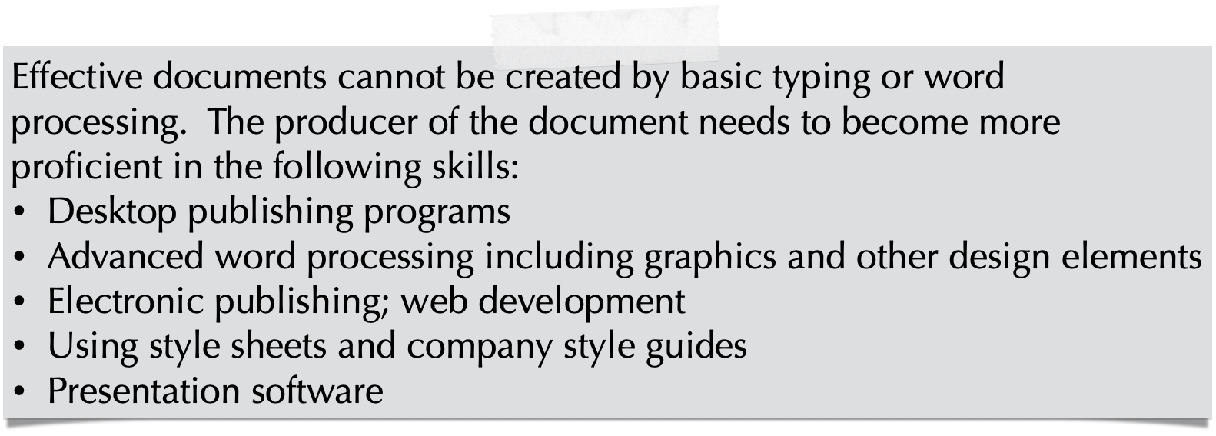
Page Design
Page Design is critical because:
Many documents rarely get reader’s undivided attention.
People read work-related documents because they have to.
Readers are attracted by documents that are inviting and accessible.
The way a document looks on a page is more important than
the text, because readers avoid boring and unattractive
presentations.
Design Skills Needed
Letters
Memos
Brochures
Pamphlets
Fact Sheets

Slide 88
Designing Pages and Documents
Shaping the Page
Use the right paper and ink; light colored paper and dark ink is best
Use consistent page numbers, headers, and footers
Use a grid for “blocking out” or shaping the page
Use adequate white space
Provide ample and appropriate margins and font sizes
Keep line length reasonable
Keep line spacing consistent — within and between paragraphs and sections;
double spacing between paragraphs and sections, single spacing within
Tailor each paragraph to its purpose; short paragraphs for emphasis
Make lists for easy reading
Highlighting for Emphasis
Fonts: Different sizes; bold; italic; minimal underlining; color
White space around important items; the document should not be “cramped”
Other graphics devices: lines; shapes; borders; visuals
Using Typography Effectively
Select appropriate fonts that are easy to read
Use type sizes that are easy to read
Use capital letters sparingly and never for more than a few words

Slide 89
Designing Pages and Documents
Fonts (Typefaces): Proper Usage
Use standard type sizes (10 to 12); larger for headers
Use appropriate fonts “professional, businesslike”
Use serif fonts for large amounts of text (See below)
Use sans serif fonts for headers, visuals, etc. (See below)
Do not use capital letters for more than a word or two
Highlight with bold or italic; avoid underlining
Do not use unusual, “funky,” or non-professional fonts such as:
Comic Sans MS
Cracked
Edwardian Script
Broadway

Slide 90
Designing Pages and Documents
Fonts (Typefaces): Most Used
The most used serif type faces are:
Times New Roman (most used by far for readability)
Palatino
Cambria (default serif font in Microsoft Word)
This section uses the Times New Roman Font
The most used sans serif type faces are:
Arial
Helvetica
Tahoma (used on many websites)
Calibri (default sans serif font in Microsoft Word)
This section uses the Arial font.
Professional documents use only two to three fonts — at least one serif font (for larger bodies of text) and one sans serif font for titles, headers, etc.

Slide 91
Page Design Guidelines
Lists
Best method for creating readable documents
Replacing comma after comma after comma
For three or more items
Bullets are always used with lists to make them stand out
Bullets for random, non-prioritized lists
Numbers for prioritized or sequential or chronological lists (steps, for example)
Excellent method for answering questions
Note: If you learn nothing else, make sure you use lists in your writing.

Slide 92
Page Design Guidelines
Line Spacing
Effective writing is always single spaced within paragraphs (not like academic papers or other documents)
Double spacing is used to separate paragraphs and sections
Paragraphs should not be indented
Triple spacing should never be used
New major sections should begin on a new page
Spacing for signatures should leave enough room for the size of the signature

Slide 93
Page Design Guidelines
Parallelism
Assuring that all items in a list begin the same way, such as:
Nouns (including gerunds - verbs changed to nouns by adding “ing”)
Verbs (particularly imperative voice - “do this” when giving directions)
Examples:
Directions (imperative voice)
Open the package
Read the directions
Insert Tab A into Slot B
Stand on your head
Call your grandmother for help
Verbs (Employment History in a resume, for example):
Supervised 20,000 minions
Managed $200 million in offshore accounts
Jumped out of tall buildings
Shredded two tons of accounting documents
Provided bail for associates
Nouns (often a list, such as a shopping list)
Tomatoes
Doughnuts
Rib-eye Steaks
Excedrin
Gerunds (nouns from verbs)
Jumping
Diving
Walking
Running
Sniffing

Slide 94
Formatting Headings
Headings should follow the format below:
Section Heading
Section headings in boldface and enlarged type are more appealing and readable than headings in full capital
letters. Use a font size roughly four (4) points larger than body copy; for example, 16 point section headings for 12 point body (paragraph) copy. Avoid overly larger section heads, and use no other highlights. Set these
and all lower headings one extra space below any preceding text.
Major Topic Heading
Major topic headings are flush with the left margin and the block style paragraph. Each important word begins with an uppercase letter. Use boldface and a font size roughly two (2) points larger than body copy, with no other highlights.
Major Topic Heading
Minor topic headings are also flush with the left margin and the block style paragraph. Each important word begins with an uppercase letter. Use boldface (italics optional) and a font size the same as the body copy, with no other highlights.
Subtopic Heading. Instead of placing the heading above the paragraph, place subtopic heading flush left to the margin and the block style paragraph on the same line as the following text. Each important word begins with an uppercase letter. Use boldface and a font size the same as the body copy, with no other highlights.

Slide 95
Professional Writing
Writing
Scientific
Reports

Slide 96
Scientific Reports
A Scientific Report is written:
To find a cause (to solve a problem) OR
To determine an effect (to answer a question) OR
To make a comparison (to make a choice or decision)
To report on a study, an experiment, an investigation, or other research which has already been completed, written in the past tense, reporting on what has previously been done
To make a Recommendation, based on the Findings and Conclusion … never, ever just to provide information … this is what makes it different from other types of reports

Slide 97
Scientific Reports
No one writes an scientific analytical report, unless:
Someone or some organization:
Pays you to write it
Requires you to write it (your boss or your
Writing 212 Professor)
Requests you to write it (a friend, work associate,
or family member)
Note: If you write scientific analytical reports for fun, you
need serious therapy.

Slide 98
Analytical Reports
The only purpose of an Analytical Report is:
To make a recommendation
The recommendation is based upon the Findings and Conclusion Sections of the Report
The recommendation is the last thing you do in the Analytical Report itself (Front Matter and End Matter may be added afterward, but they are not part of the actual report
The recommendation is what sets an Analytical Report apart from all other reports

Slide 99
Scientific Thinking and Writing:
How We Think
Every scientific analysis or analytical report requires a particular approach to
begin the analysis: a pattern of thinking. There are six (and only six)
possible approaches to begin an scientific analysis.
The Six Basic Thought Patterns Are:
Cause: What causes X? or Why does X happen?
Effect: What are the effects or results of X?
Comparison: How does X compare to Y (and Z, etc.)
Improvement: How can X be improved?
Alternative: How does X work in other situations or at other times?
Feasibility: Is X feasible? Can it be done?
One or more of these questions must be used
to begin an analysis or analytical report.

Slide 100
Obtaining Information
for an Scientific Report
First Hand Information
Laboratory testing or other scientific methods
Direct observation on on-site
Second or Third Hand Information
Books, Magazines, Journals, etc: Print media
Internet, Search Engines, Social Sites: Electronic media
Experts: Persons certified in a specialized area
Surveys and Interviews: Information filtered by judgment and bias
Classes, Seminars, Training: Information filtered by instructors
The best and most reliable information is first hand; all other information has been filtered at least once (including college classes
and college teachers); reference must be made to this information —
that is, where it came from.

Slide 101
Scientific Reports
Scientific Report Characteristics
Used to address situations that require critical
thinking, direct observation, and research
to arrive at a conclusion
Ends with a recommendation (the difference between analytical reports and other kinds of reports) or an action plan which may have the following results:
The recommendation may be accepted and implemented
The recommendation may be ignored or rejected
The recommendation may cause additional studies to be conducted
The recommendation may lead to requesting proposals to carry out the recommendations (the World of Work cycle)

Slide 102
Analytical Reports
Model for a Analytical Report
COVER PAGE
TITLE PAGE
LETTER OF TRANSMITTAL
TABLE OF CONTENTS ii
ABSTRACT iv
INTRODUCTION 1
Background 1
Purpose of Report 2
Qualifications of Consultant 2
Data Sources 4
Scope and Limitations 5
COLLECTED DATA 5
Analysis of Product #1 6
Laboratory Analysis 6
Client/User Surveys 6
Review of Specialized Literature 7
On-Site Testing 8
Summary of Findings 9
Interpretation of Findings 9
Analysis of Product #2 9
Laboratory Analysis 9
Client/User Surveys 10
Review of Literature 11
On-Site Testing 11
Summary of Findings 12
Interpretation of Findings 13
CONCLUSION AND RECOMMENDATIONS 14
Summary of Findings 14
Conclusions 15
Recommendation 15
APPENDIXES 16
Appendix A. Laboratory Testing 16
Appendix B. Sample Questionnaire 20
Appendix C. Internet Sources 25
Appendix D. Comparative Statistics 26
Primary Sections
Cover Page
Title Page
Letter of Transmittal
Table of Contents
Abstract
Introduction
Collected Data
Conclusion
Appendixes
Glossaries
References
Front Matter
Main Sections
End Matter

Slide 103
Scientific Reports
Elements of a Effective Scientific Report
Clearly identified problem or goal
Adequate but not excessive data
Accurate and balanced data
Objective data without personal bias
Fully interpreted data
Supported facts and data
Appropriate visuals
Accessible page design
Valid conclusions and recommendations
Self assessment
Logical organization
Clear process from identification to
recommendation

Slide 104
Scientific Reports
Sample Scientific Report Types
Causal Analysis
Make sure the cause fits the effect
Make the links between cause and effect clear
Clearly distinguish between possible, probable, and
definite causes
Comparative Analysis
Make the comparison on clear and definite criteria
Give each item balanced treatment
Support and clarify the comparison through credible examples
Follow either a block pattern or a point-by-point comparison
Order points for greatest emphasis
In a recommendation (e.g., X is better than Y), offer final
judgment based on criteria presented
Feasibility Analysis
Consider the strength of supporting reasons
Consider the strength of opposing reasons
Recommend a realistic course of action

Slide 105
Organizing Information
Partitioning and Classifying
Partitioning separates information into parts,
sections, or categories
Classifying sorts a variety of things that share
certain similarities
Sequencing
Spatial: begins at one location, ends at another
Chronological: follows the sequence of events
Effect-to-cause: identifies a problem, then traces its cause
Cause-to-effect: follows an action to its results
Emphatic: reasons are offered in support of a particular viewpoint
Problem-causes-solution: describes problem, diagnosis, offers solution
Comparison-contrast: evaluates two or more items in relation to each other
Chunking
Breaks information down into discrete, digestible, understandable units
Uses visual design techniques to highlight information

Slide 106
Findings
Findings are the information you provide to the reader.
Keep in mind the following:
Evaluating Information
Is the information accurate, reliable, objective and unbiased?
Is the information verifiable?
How much of the information is useful?
Has all the necessary information been provided?
Interpreting Information
Are my findings in keeping with the intent of the research?
Does any of the information conflict?
Should the evidence be reviewed or reconsidered?
What, if anything, should be done?
Do the findings lead to conclusions and recommendations?
Are other interpretations possible?
Has any personal bias affected the interpretations?

Slide 107
Sources for Findings
(Where to find information)
Hard Copy (Print) Sources | Electronic Sources
+Organized and searched by librarians and other professionals | +More current, efficient, and accessible
+Often screened by experts for accuracy | +Searches can be narrowed or broadened
+Easier to preserve and keep secure | +Can offer material that has no hard copy equivalent
-Time consuming and inefficient to research | -Access to recent material only
-Offers only text and images | -Not always reliable
-Hard to update | -User (reader, audience) might get lost
Plus (+) and Minus (-)

Slide 108
Summaries/Abstracts
(Summarizing information)
An abstract or summary:
Gives an overview of what the document is about
Helps users/readers decide how much to read
Gives a framework for understanding the body of the document
Is prepared after the document has been completed
Is presented at the beginning of the document, describing what the
document contains or covers
Helps guide the thinking of decision makers

Slide 109
Effective Writing
Writing
and
Editing

Slide 110
Proof Read (or proofread)

Slide 111
Writing Style
The way you construct each sentence
The length of sentences
The way you connect sentences
The words and phrases you choose
The tone you convey
Tone
Use an occasional contraction
Address the reader/user directly when appropriate
Use the active voice and action words
Emphasize the positive
Be professional, but not overly formal or stilted
Avoid personal bias or opinion
Avoid sexist language
Avoid offensive usage or current overused words

Slide 112
Using Exact and Specific Words
Use simple and familiar wording
Avoid abstract words; use specifics — words you can “point to”
Avoid useless jargon
Use acronyms selectively
Avoid triteness, overused phrases, and “what everyone says”
Avoid misleading euphemisms
Avoid overstatement
Avoid imprecise wording
Be specific and concrete; not abstract and general
Make sure spelling and grammar are correct; don’t rely on
“word processor corrections”

Slide 113
Writing and Editing for:
Clarity
Avoid ambiguous pronoun references
Avoid ambiguous modifiers
Unstack modifying nouns
Arrange word order for coherence and emphasis
Use active voice whenever possible
Use passive voice selectively
Avoid overstuffed sentences
Conciseness
Delete needless to be constructions
Avoid excessive prepositions
Fight noun addition; use simple action words
Make negatives into positives
Clean out clutter or excess words
Delete needless modifiers
Fluency
Combine related ideas
Vary sentence construction and length, but keep them simple
Use short sentences for special emphasis

Slide 114
Save these notes for future
reference; they might just
come in handy and bring
you a fulfilled and joyful life.
Writing 213 2024 - 2025

